Slide 1

Is there a price different flying out Houston or New York?
Is non-stop fly always more expensive?

Slide 2
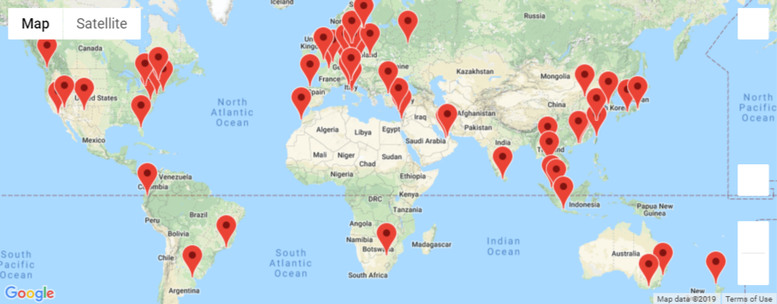
Discovering Travel Options
Team Members
Jessie Kuo
Ren Galindo
Pablo Jordan

Slide 3
Agenda:
The Why?
Popular destinations by Houstonians?
The How?
Deep Dive - Data Analysis Visualization
Price Variance of Direct vs. Indirect Flights
Want to take a vacation this December?
Kick off questions
Data Acquisition
Data cleaning and exploration
Initial Analysis
Post Mortem
Q & A

Slide 4
The Why?

Slide 5
The Why?
Are there any flights budget friendly during December holiday season?
What are the most visited cities in the world?
Where can I go with a budget friendly?
Is there a price difference flying out from another airport and city besides IAH - Houston?
Is it better to flight direct or indirect in terms of price?
Data acquired for the month of December 2019

Slide 6
The How?

Slide 7
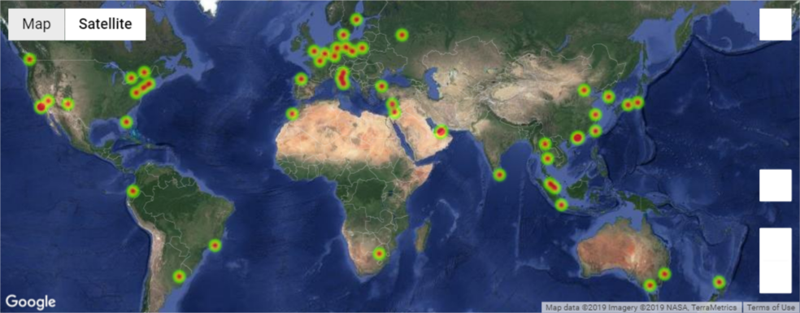
The How?
Skyscanner – Test API
Initial Analysis

Slide 8
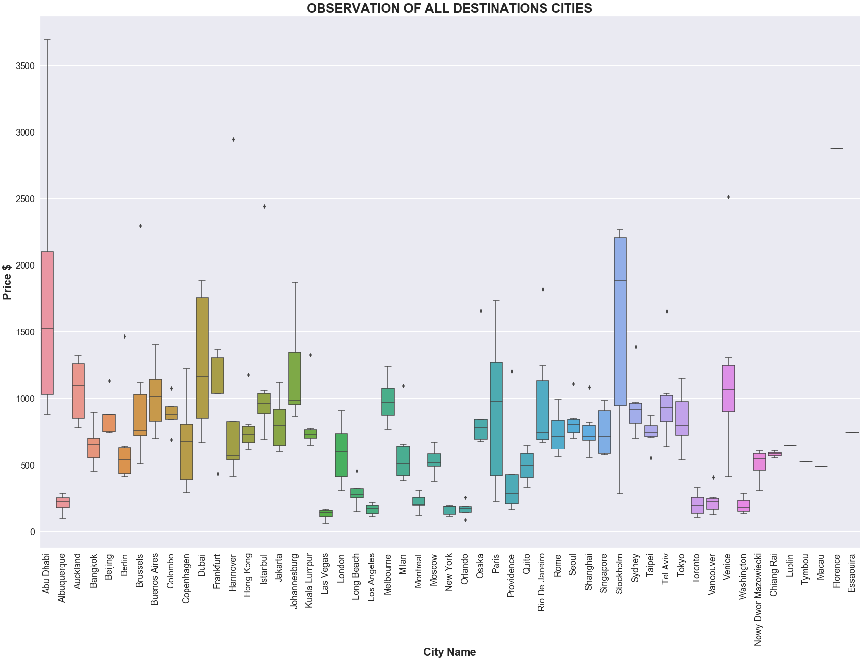
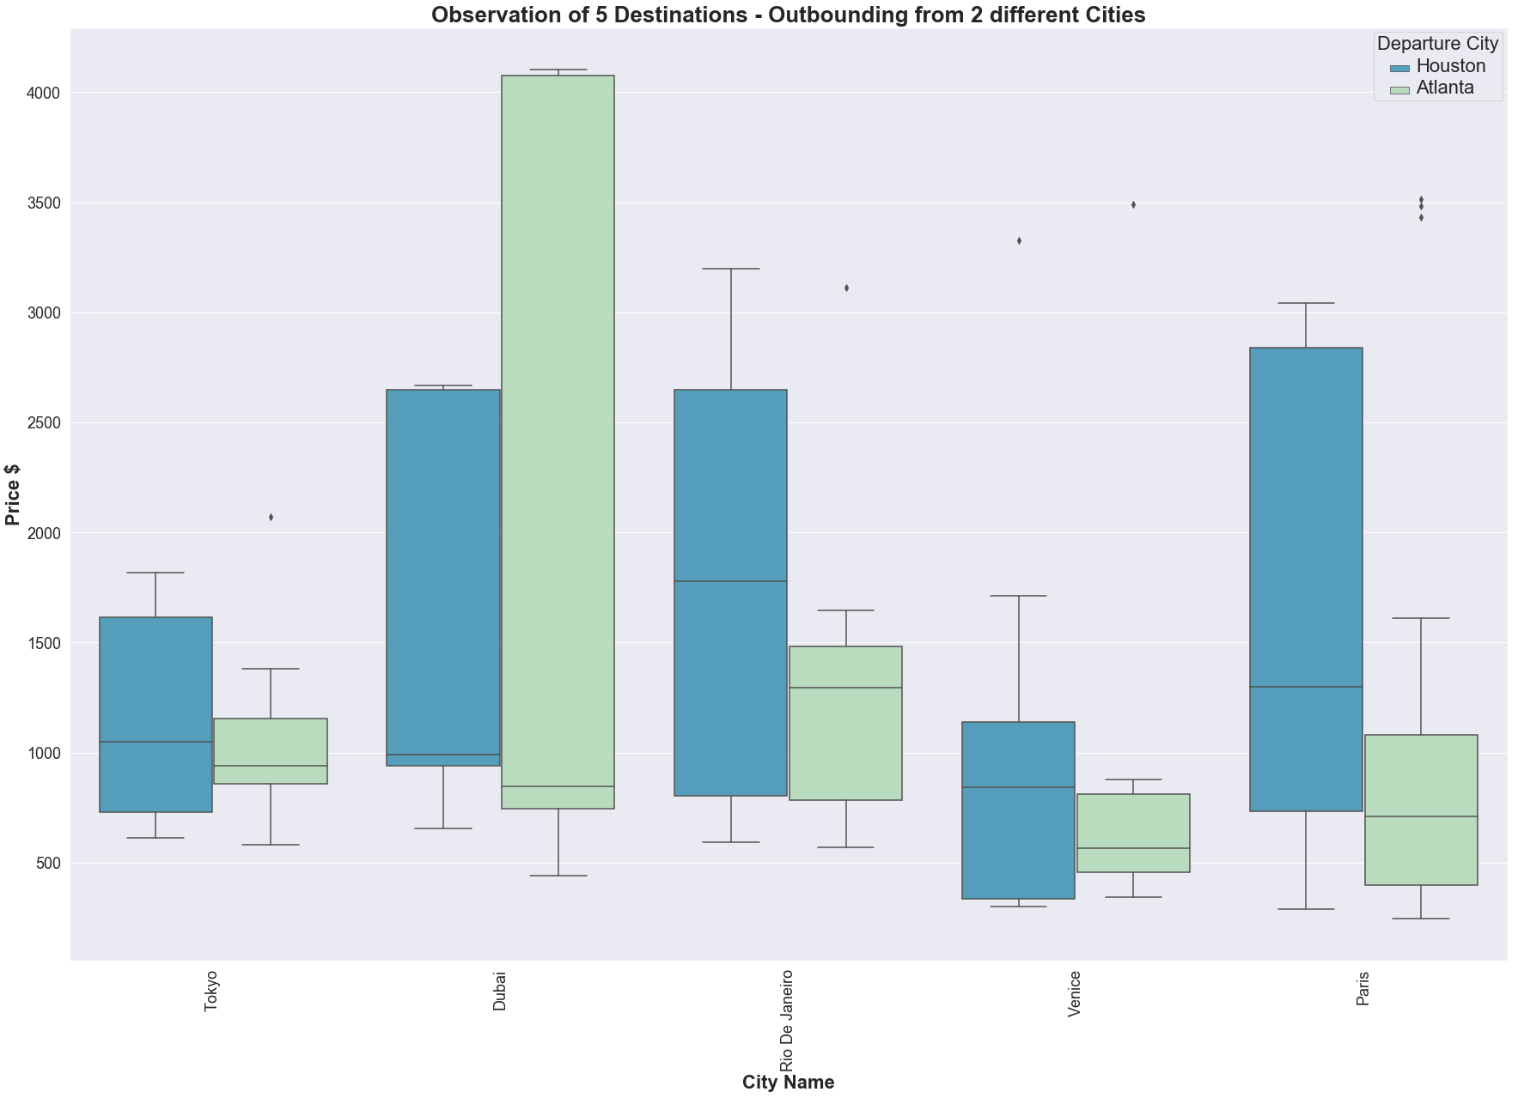
Initial Analysis – ANOVA
ANOVA – Testing Results
ANOVA – Testing Results
(statistic=1.9541614193332029, pvalue=0.0652234332283013) > 0.05 Different in sample means is NOT significant
(statistic=3.708615771307178, pvalue=0.005870175293385188) < 0.05 Different in sample means is significant

Slide 9
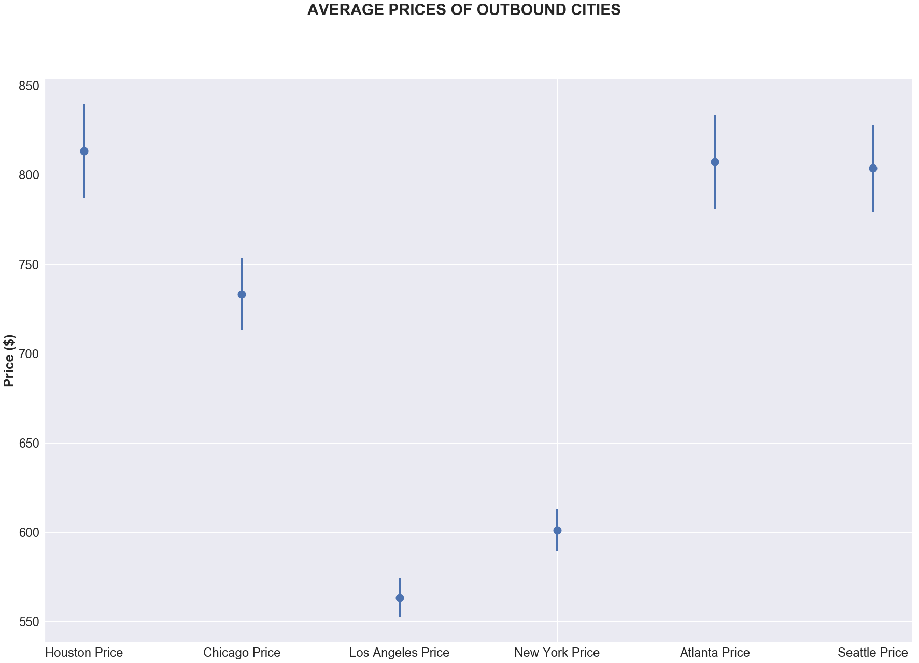
Is there a price difference flying out from another airport besides IAH - Houston?
T – Test (Independent Samples) - Results
Yes, but it depends what airport you compare with.

Slide 10
Deep Dive - Data Analysis Visualization

Slide 11

Deep – Dive
Data Analysis

Slide 12
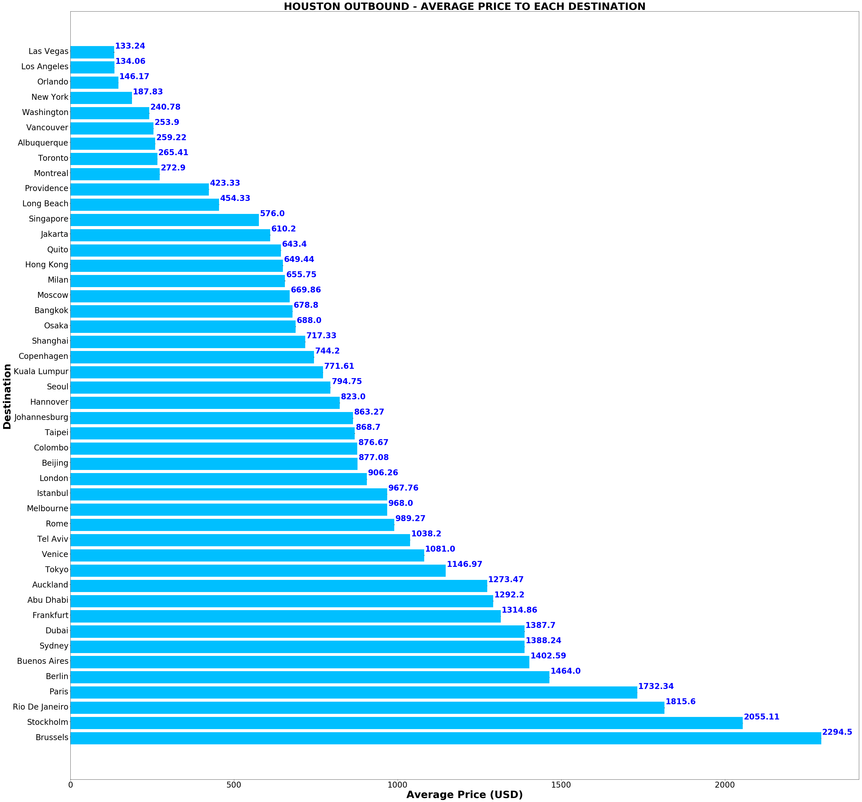
IAH: Average price to various destinations in December:
Average price is calculated based on user searches on any departure date in December.
The fares include both direct and indirect options.
We notice it’s extremely expensive to go to Brussels and Stockholm because:
There’s no non-stop options to these cities from IAH
User searches are all around the last week of December when ticket prices are usually the highest of the year.

Slide 13
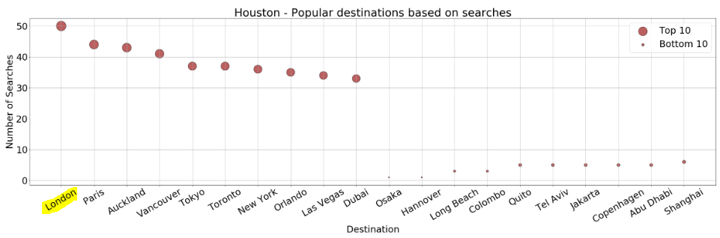
IAH: Since quotes generated are based on user searches, what are the top searched destination by Houstonians?
Does more user searches drive up the price?

Slide 14
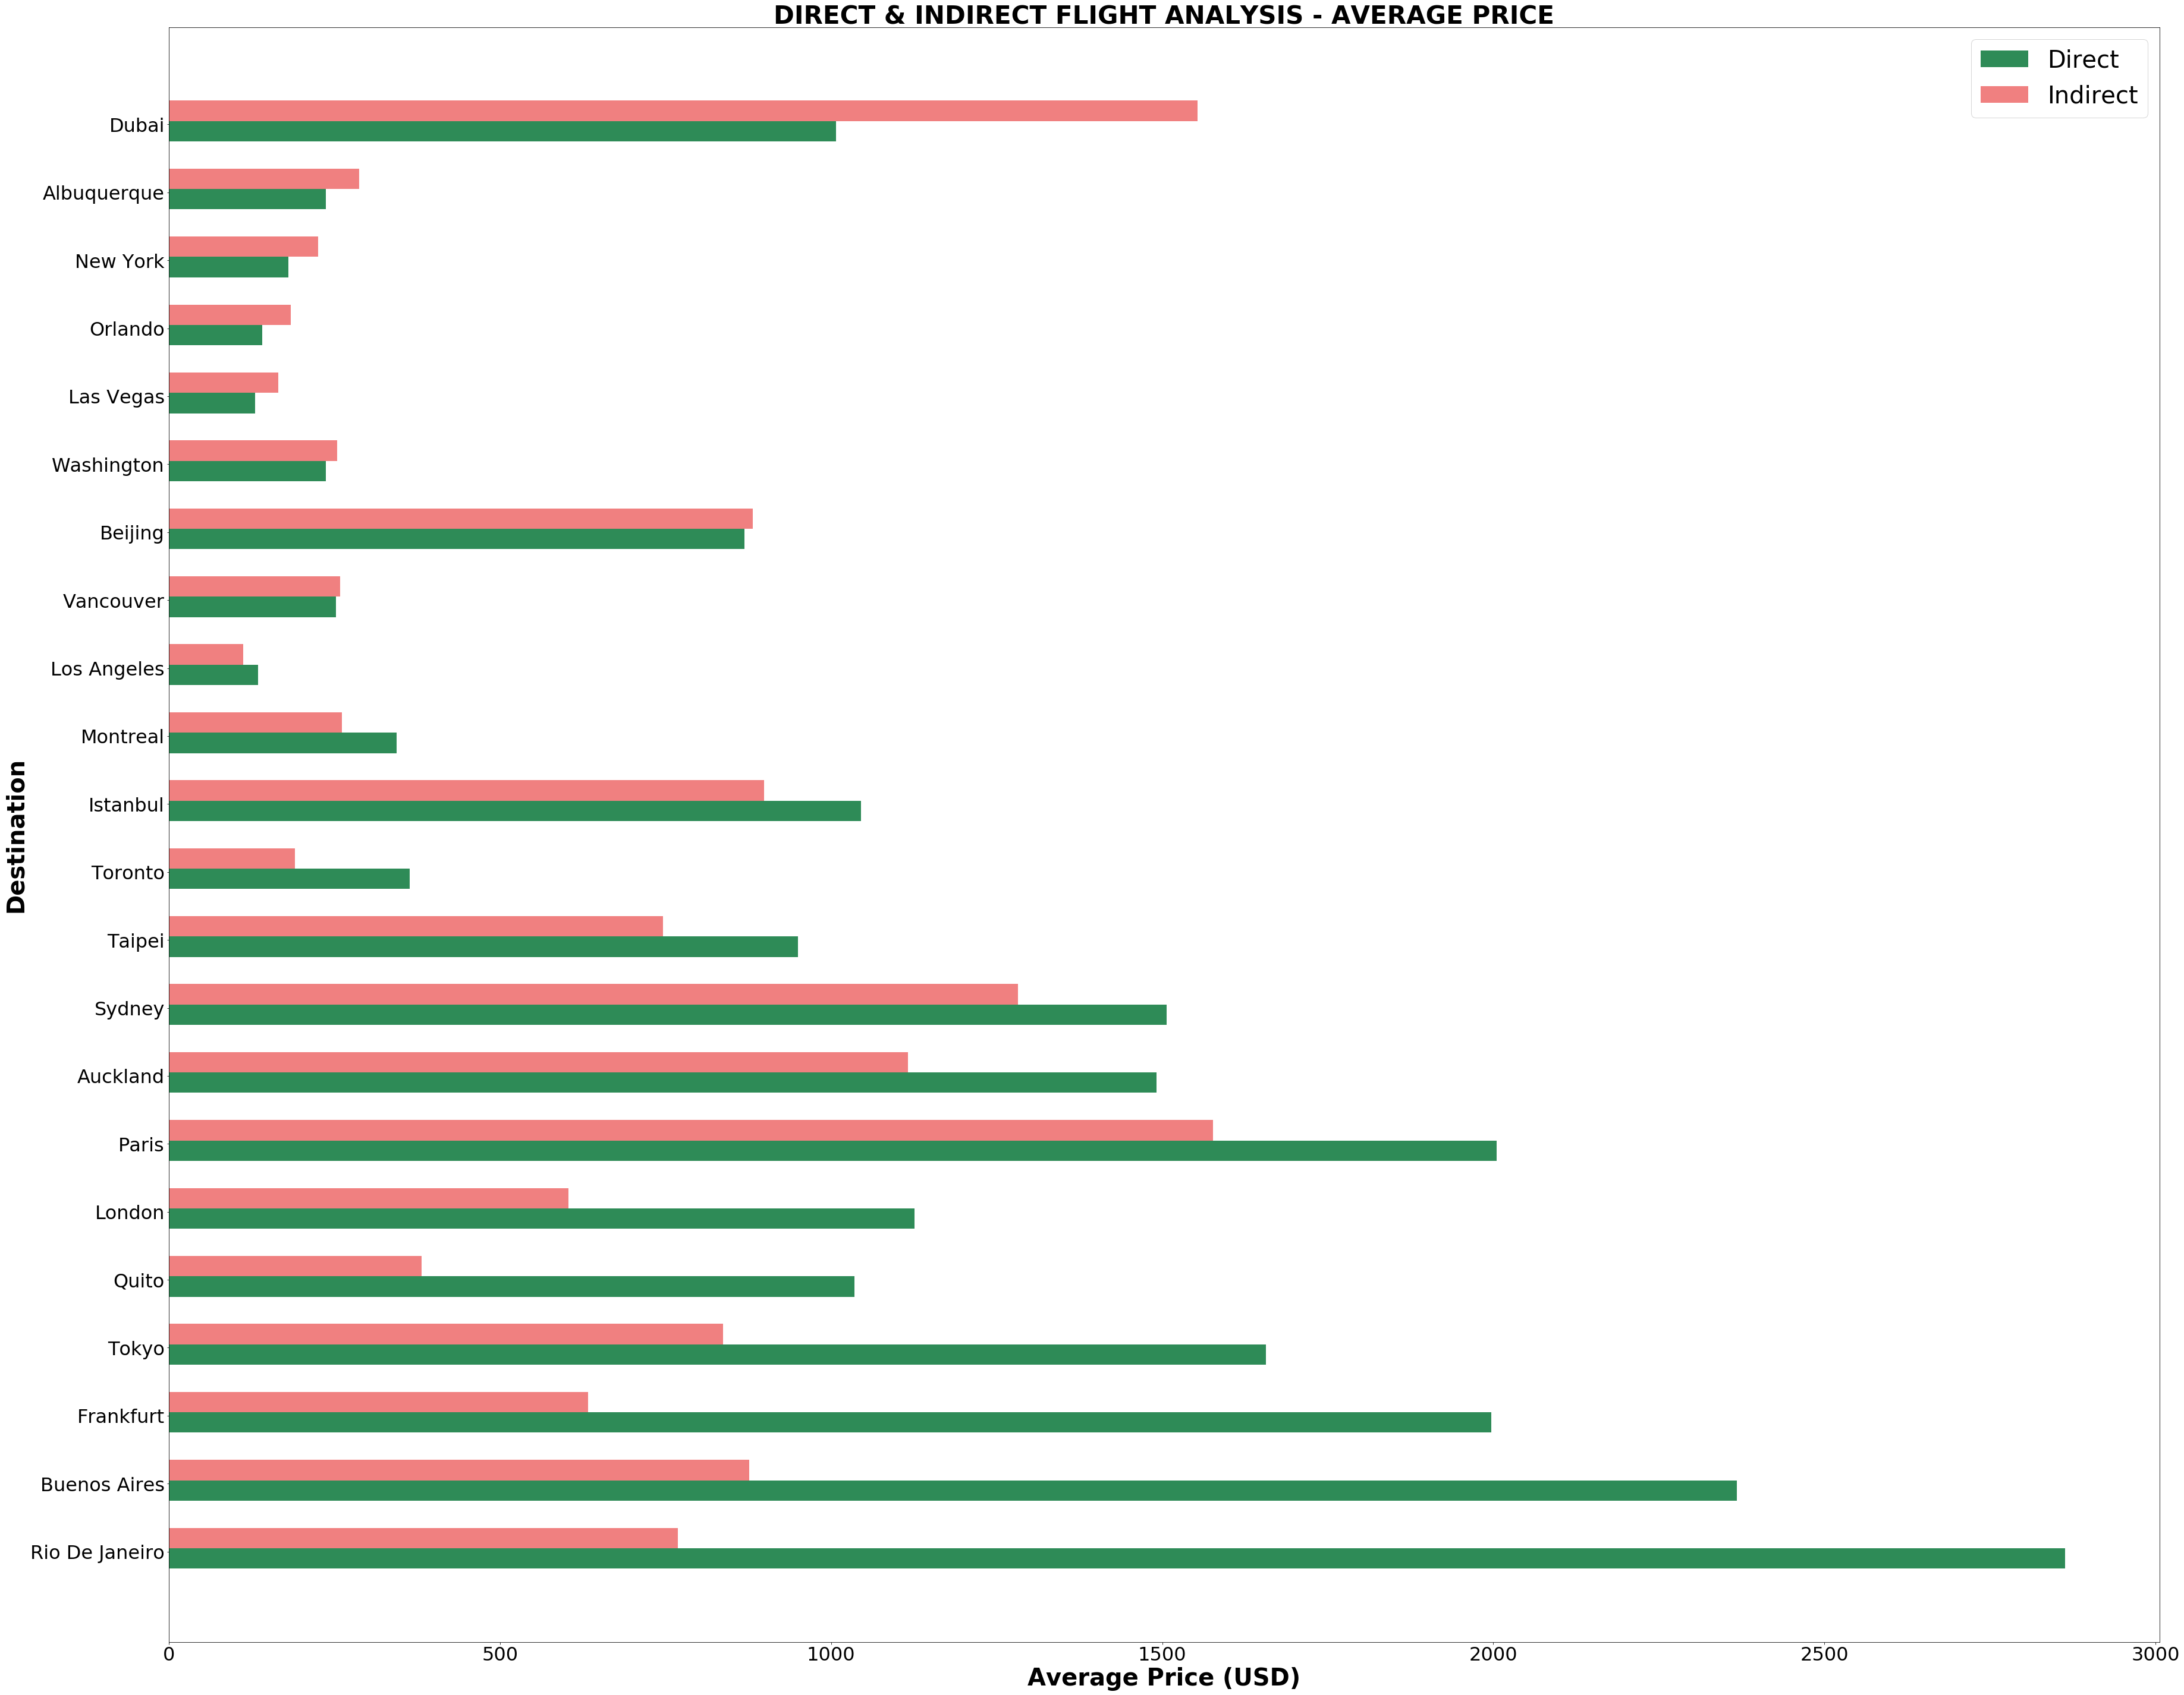
IAH: Is non-stop fly always more expensive?
Not Really!

Slide 15
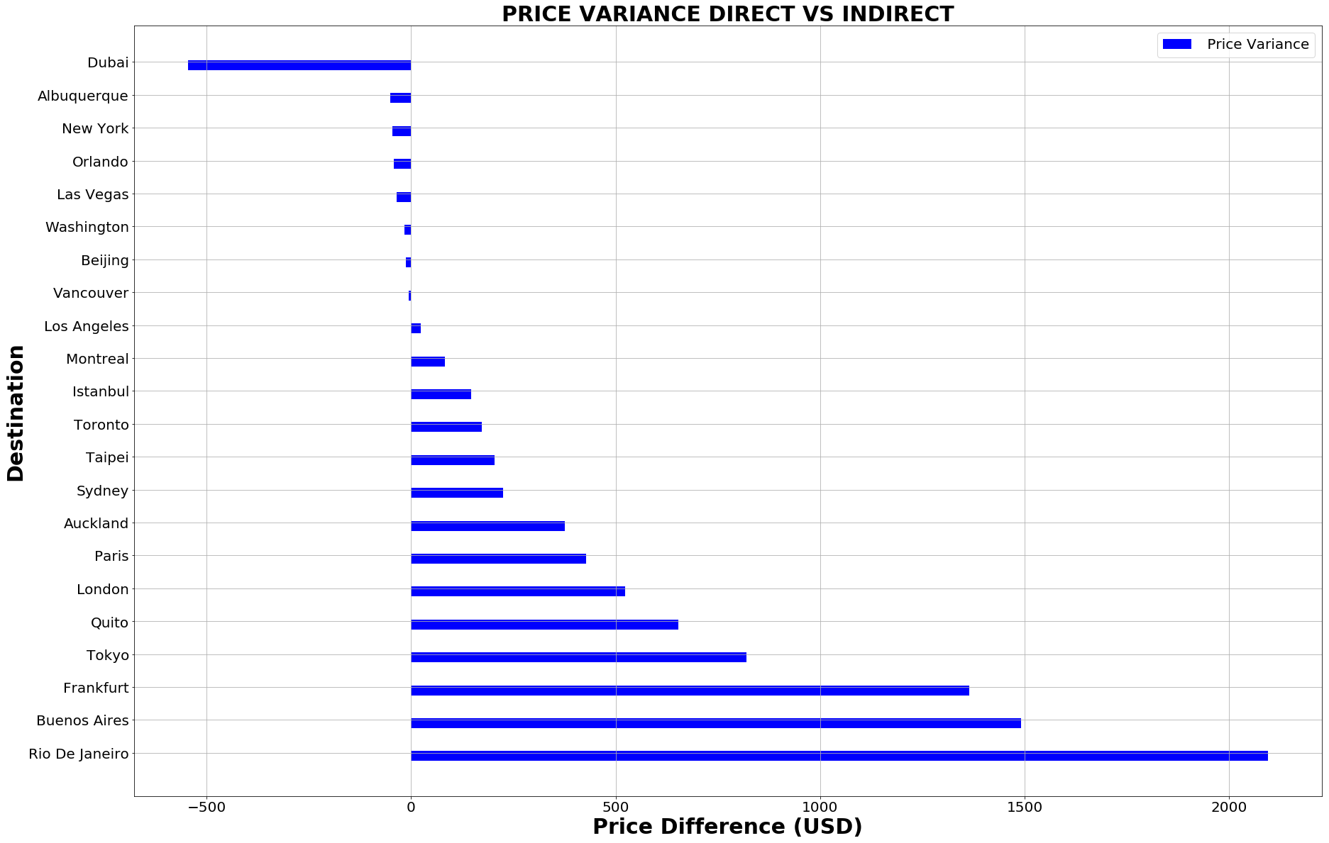
IAH: Price Variance of Direct vs. Indirect:
Observations:
Emirates offers A380 non-stop service to Dubai. Routes with connections are mostly thru KLM, British, or Delta. Prices for each segment can add up which end up more expensive in total.
Variance = Green bar (direct) - Red bar (Indirect) from the previous slide.
Baseline $0 means there’s no difference flying either way.
Lower than $0 is the price savings if flying direct.

Slide 16
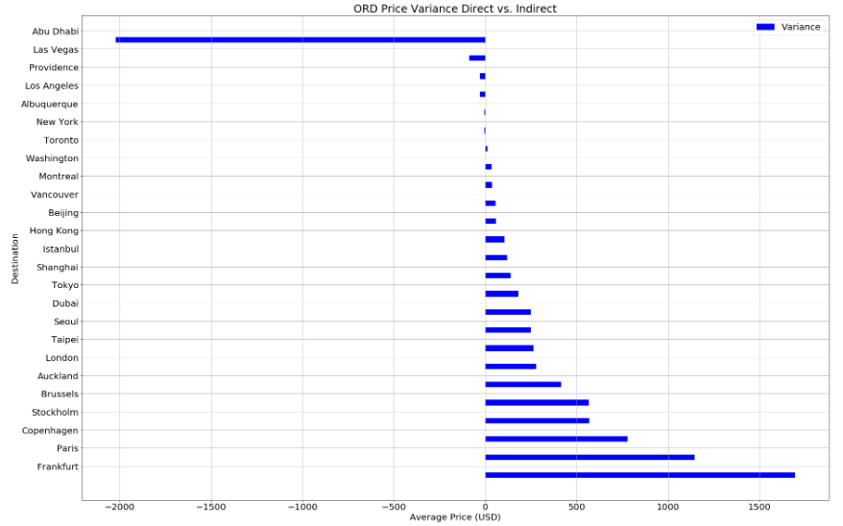
ORD: Price Variance of Direct vs. Indirect:
Observations:
If travelling within US, flying non-stop is cheaper most of the time.

Slide 17
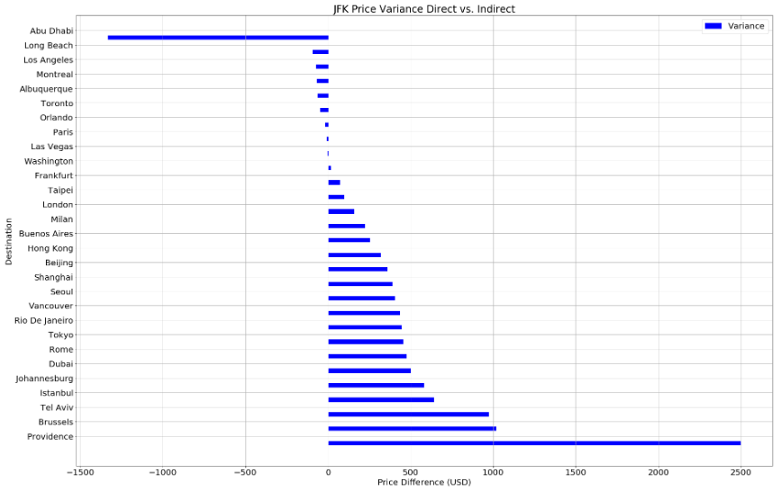
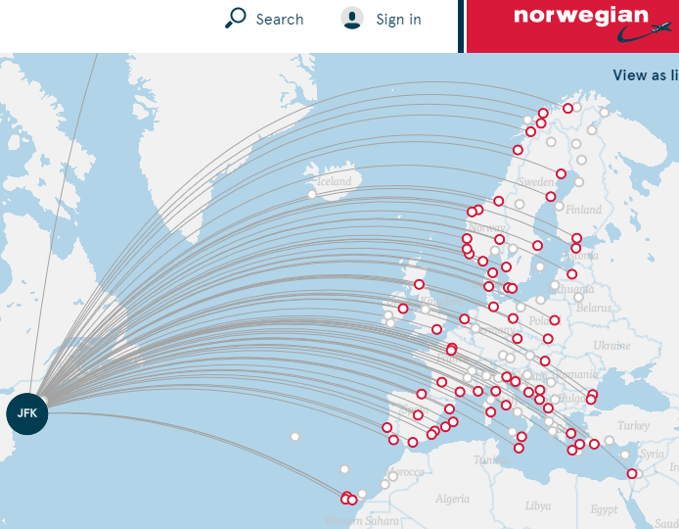
JFK: Price Variance of Direct vs. Indirect:
Observations:
Paris - Almost no difference because it’s a major hub for European budget airline - Norwegian.

Slide 18
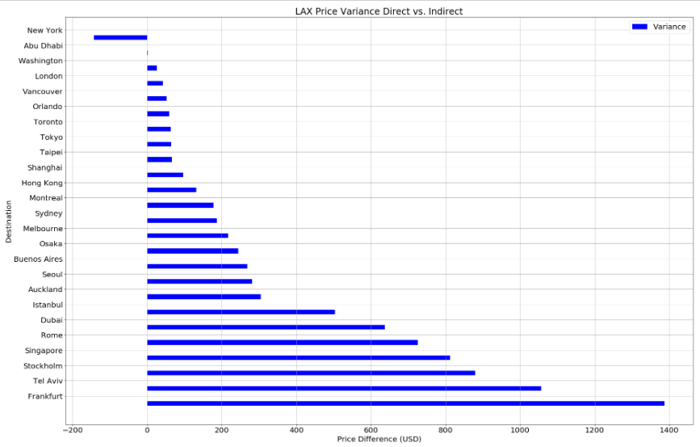
LAX: Price Variance of Direct vs. Indirect:
Observations:
Price variances are within $100 for many Asian cities because many direct flights from LAX, a major gateway to Asia.
Time is money. If price variance is less than $100 to an international location, fly non-stop!

Slide 19
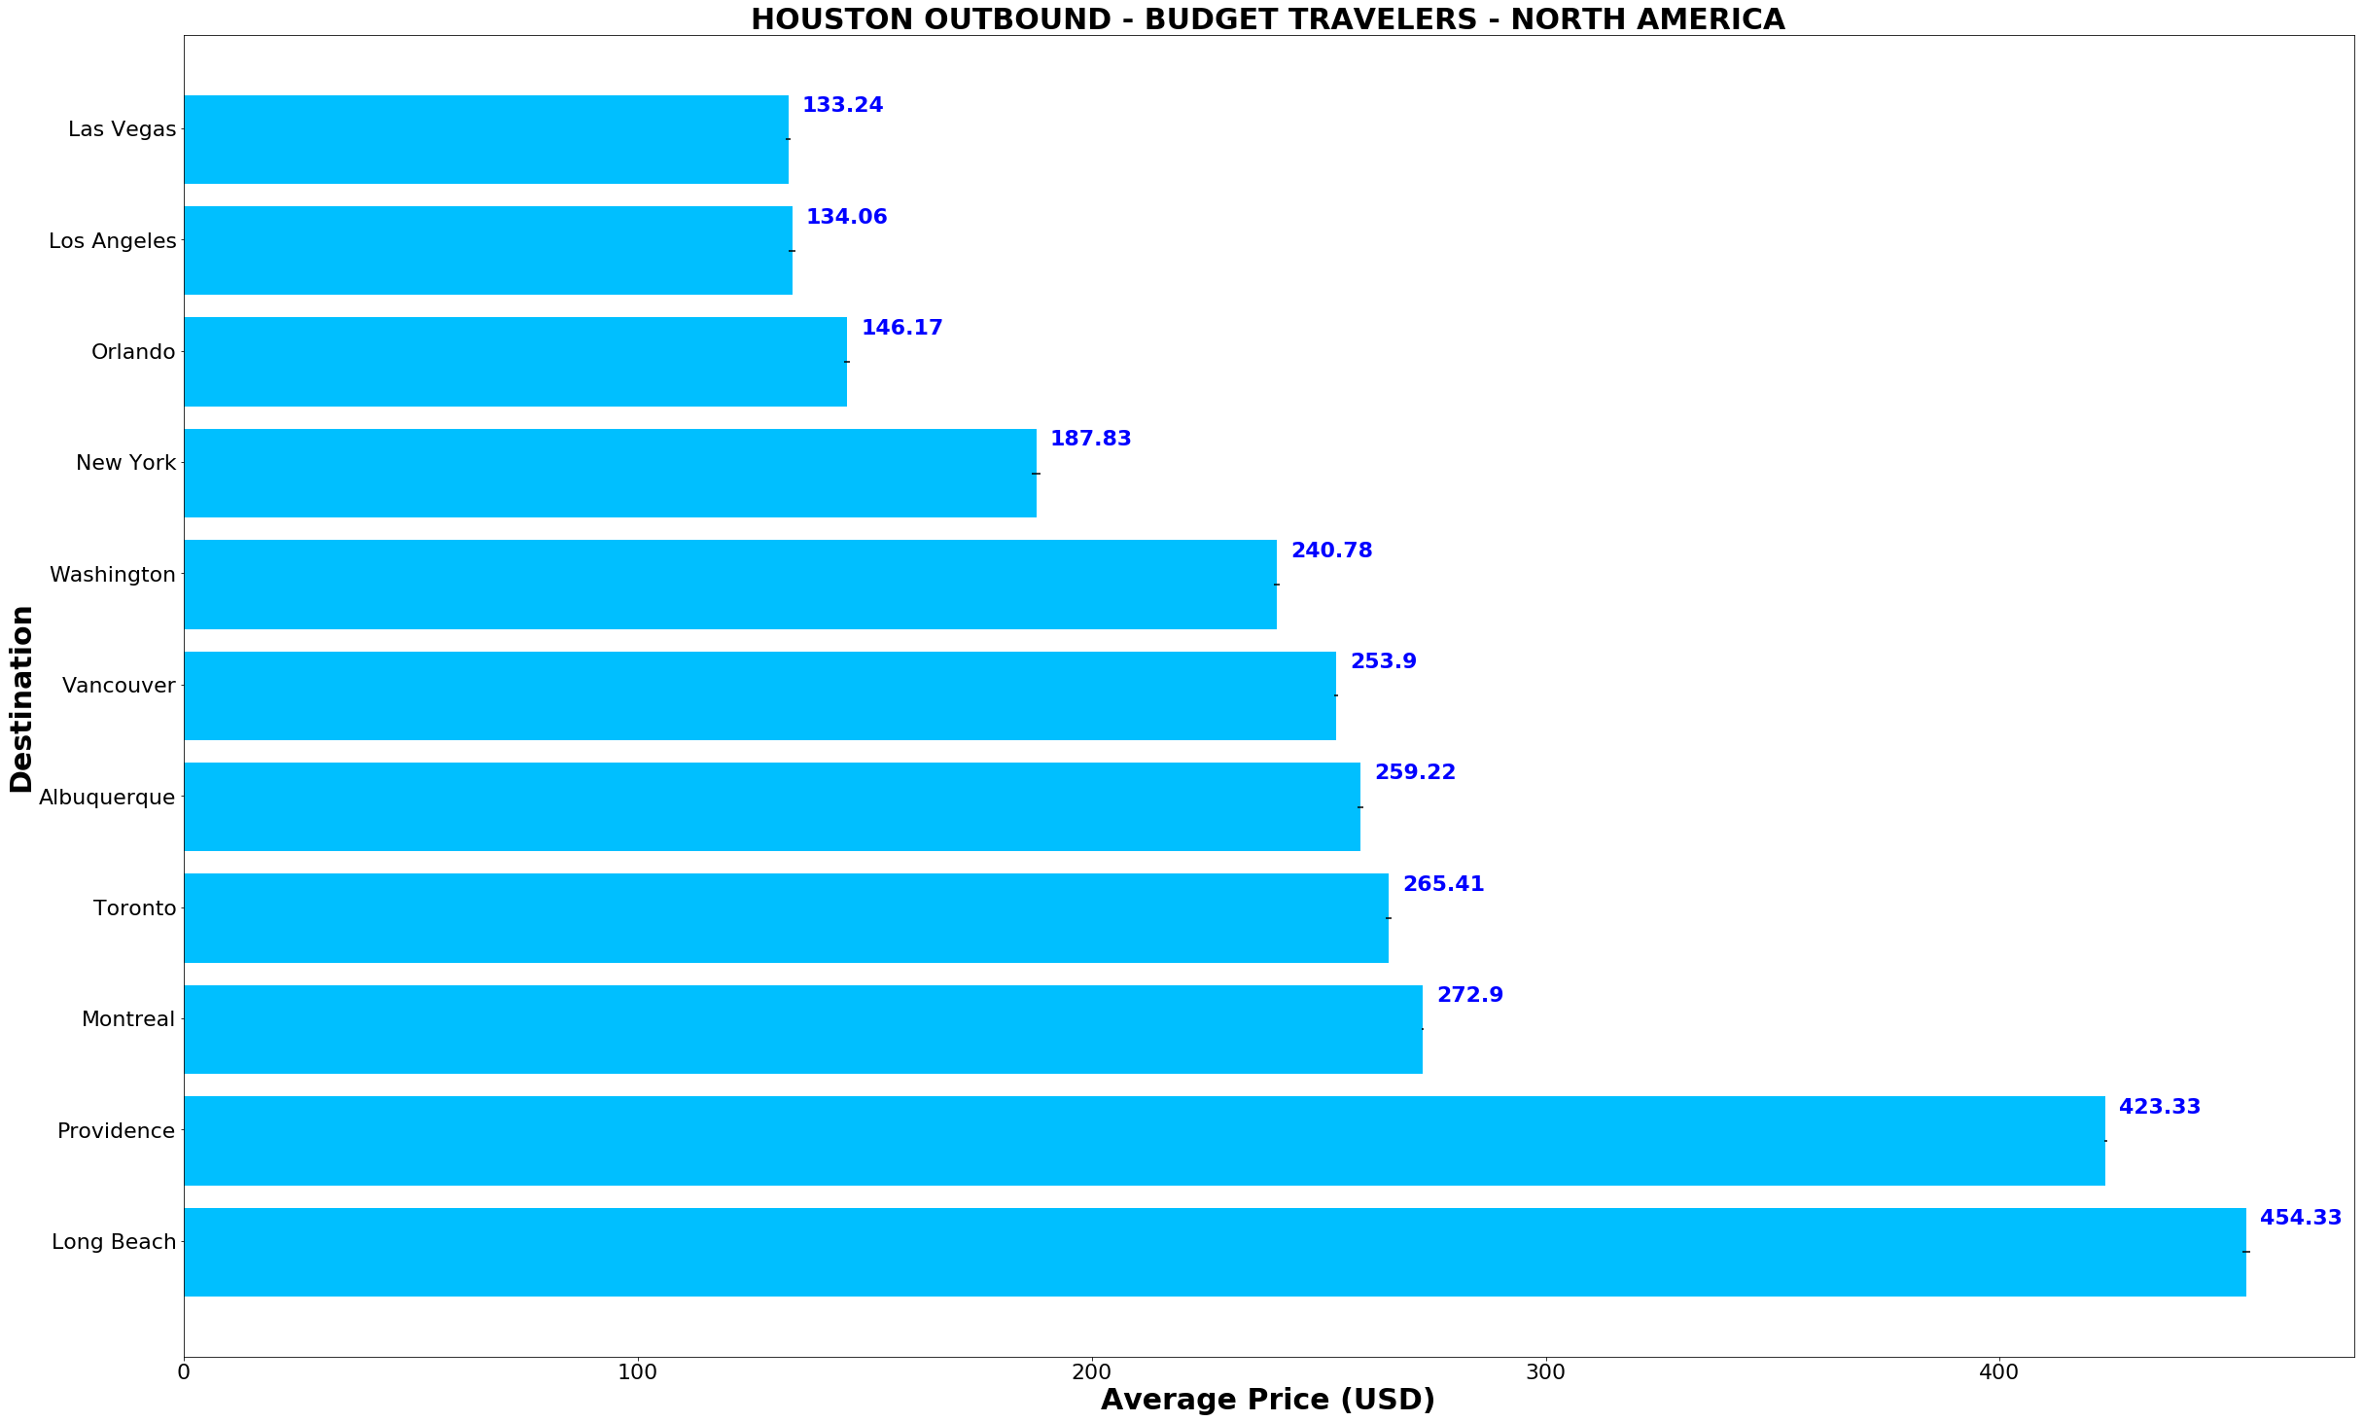
Want to take a vacation this December?
Budget Traveler (<$500)
Disclaimer:
Price subject to change and varies by booking sites. Fare presented is an average based on user searches for any departure date in month of December obtained from Skyscanner API. As prices change daily, you may or may not find the prices online after class!

Slide 20
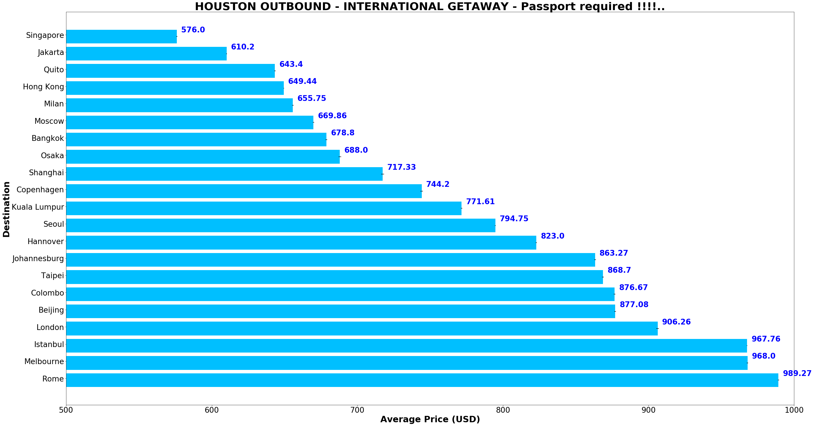
Deep Pocket ($500 to $1000)
Good deals to Asia!

Slide 21
Fun Observations

Slide 22

Question 1: JFK - Why flying to Providence, RI is so expensive?

Slide 23
Observations:
Only 3 searches are available, 2 of which depart on Christmas Eve.
The one that cost almost $3,000 is the only non-stop option.
Never heard of “Linear Air”, have you?

Slide 24
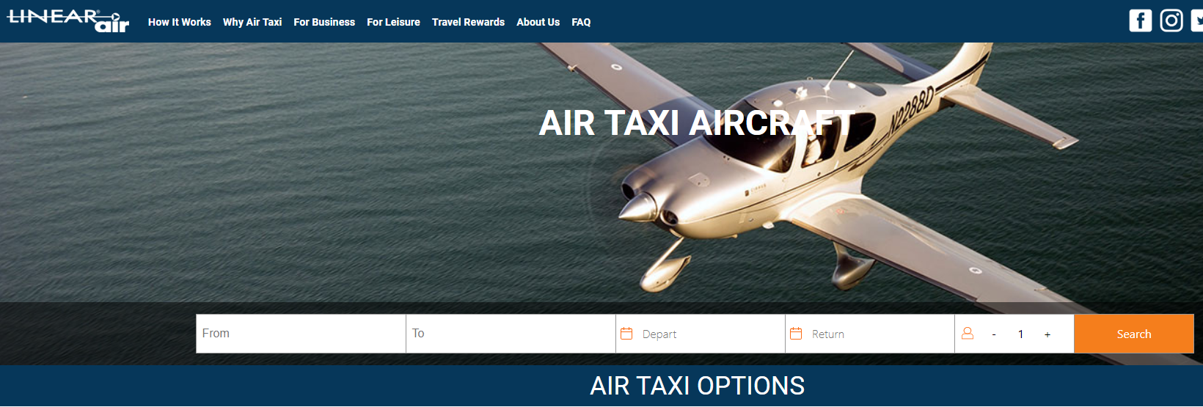
That’s Nice……..$$$

Slide 25
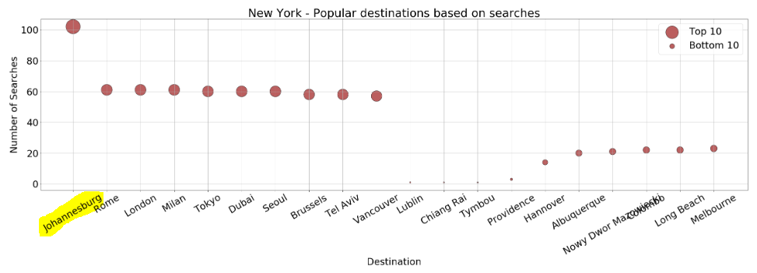
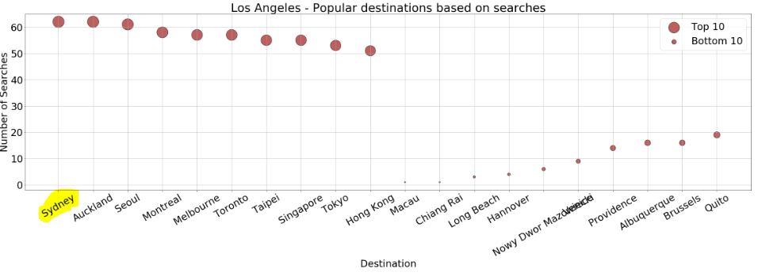
Question 2: What are the top searched destinations in east and west coast?
Observations:
New York:
1. Johannesburg – Gateway to Africa
2. Rome & Milan – Fashion Capital? Large Italian population?
Los Angeles:
1. Sydney & Auckland – Gateway to South Pacific. Qantas, Air New Zealand, Virgin Australia offer non-stop flights
2. Asia – Gateway to many Asian countries

Slide 26
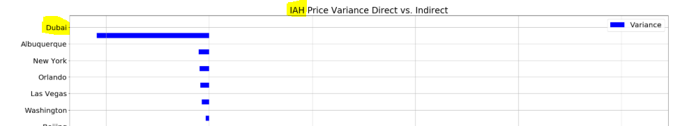
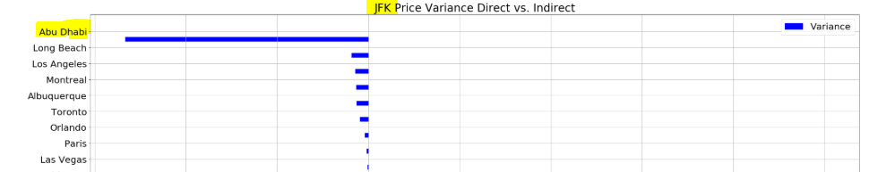
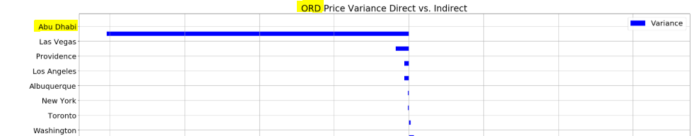
Question 3: Flying Direct to Dubai is much cheaper from IAH, but why is it to Abu Dhabi from ORD or JFK ?

Slide 27
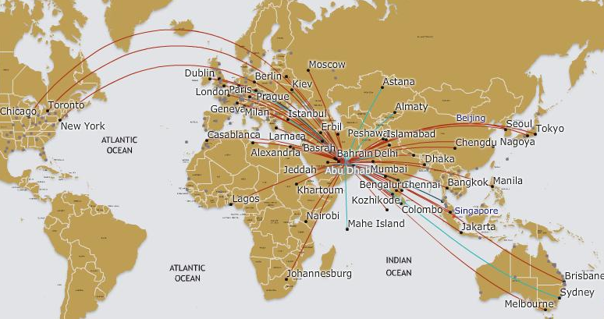
Observations:
Because they don’t come to Houston !!

Slide 28
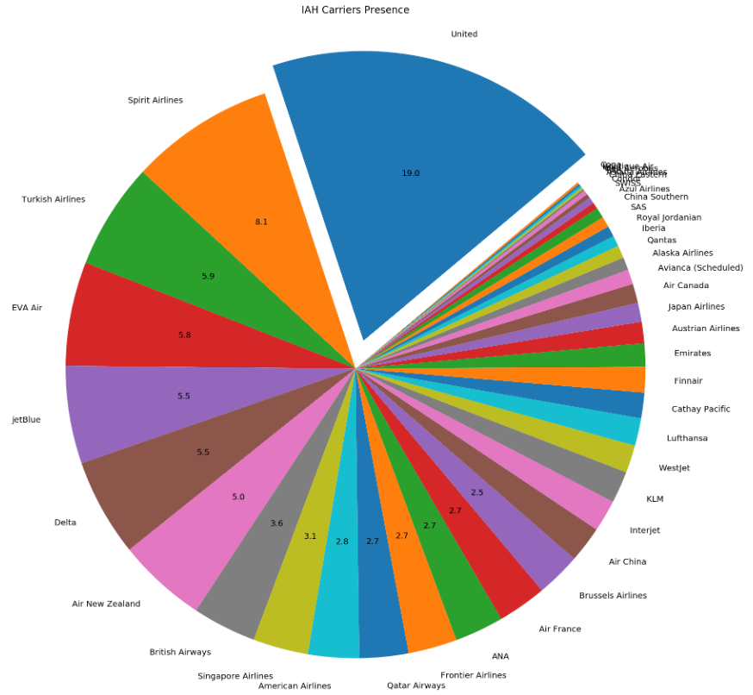
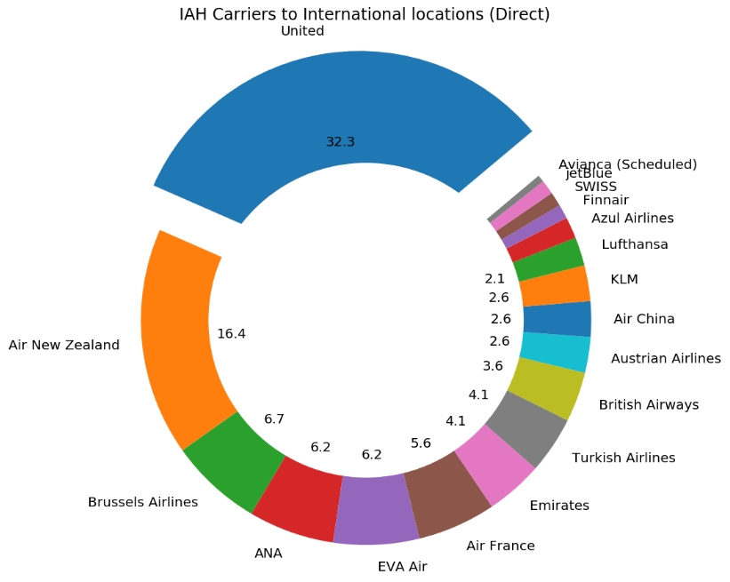
Question 4: In Houston, United is the major carrier for both domestic and international locations. How about Seattle?

Slide 29
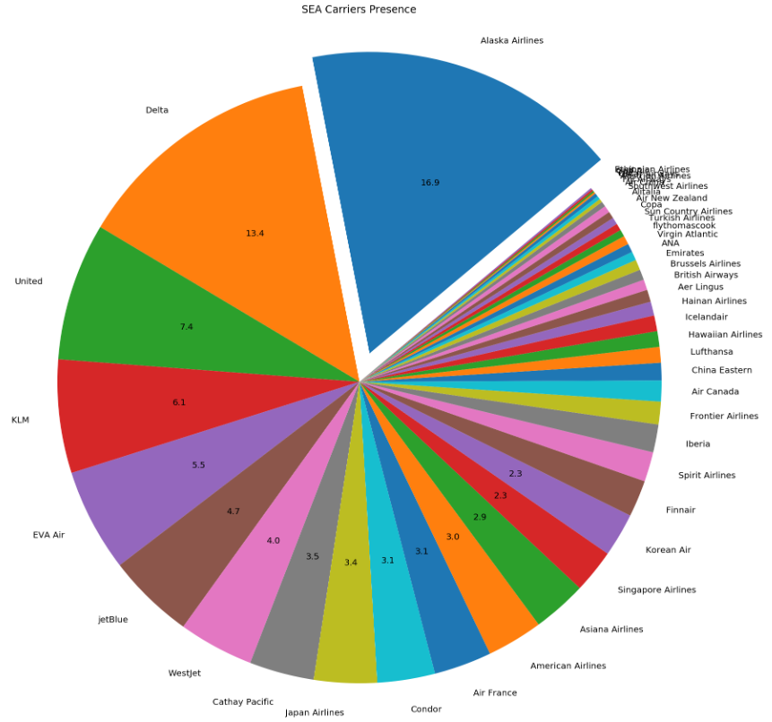
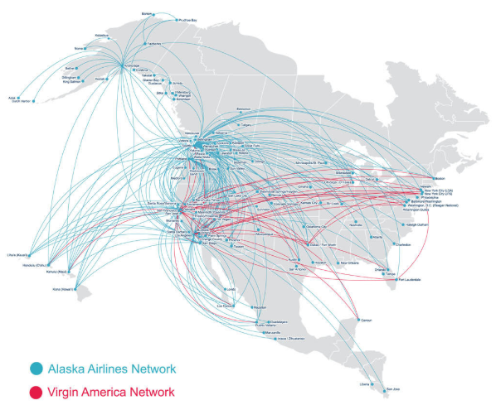
Observations:
Alaska Airline is the major carrier for domestic locations. Delta a close 2nd.

Slide 30
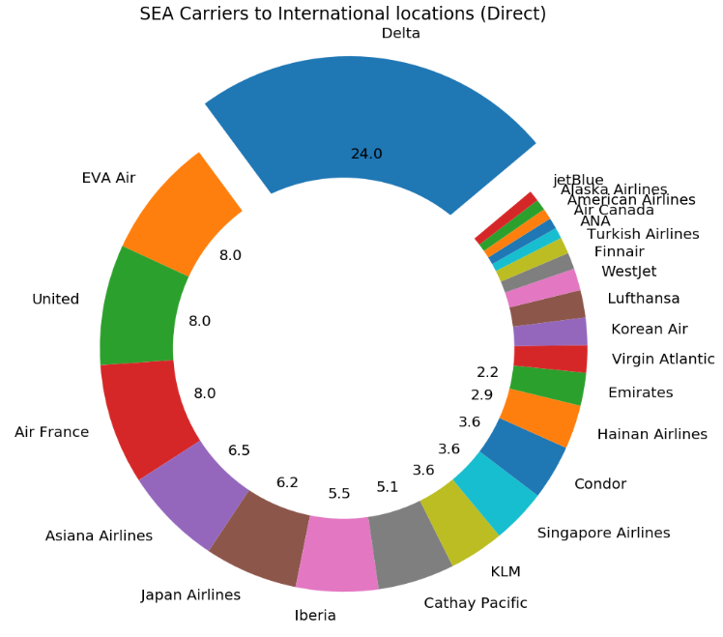
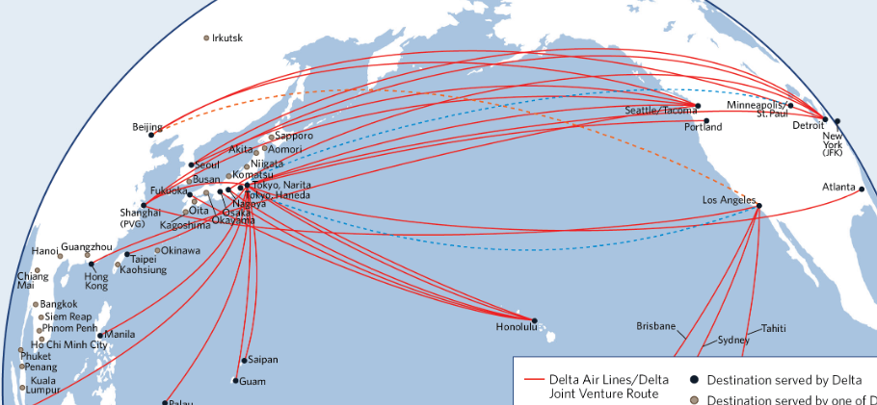
Not ATL, SEA is the major gateway to Asia for Delta
Observations:
Delta is the major carrier for international destinations.

Slide 31
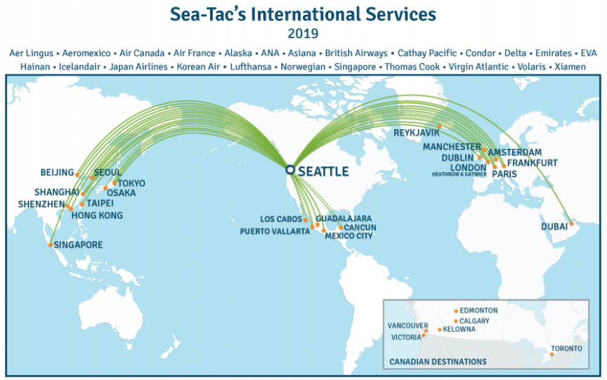

Slide 32
What’s next?

Slide 33
If we have more time…
Correlation between search count and price change. In other words, will airlines’ system consider more searches as a more popular route?
Add a Webcam API showing live webcam for each city discussed in this presentation.
Analyze the exact date and travel time quoted by Skyscanner API. Our data is based on quotes searched in month of December. However, travelling less than a week before Christmas is much more expensive than travelling in the beginning of December.
Identify variables that have direct impact to price. Is it destination? Is it number of flights per day? Is it location?

Slide 34

Questions?

